Slide 1
More Classification
IUT AI Student Chapter

Slide 2
SVM

Slide 3
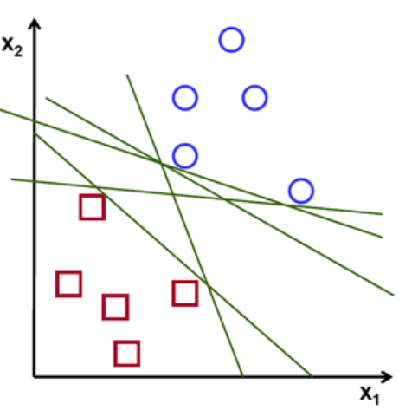
Support Vector Machines
Which one is a better hyperplane ?
How should we choose the best ?

Slide 4
SVM
W 丄 Hyperplane
u : unknown point
Decision Rule?
W.u > c ?
u
W

Slide 5
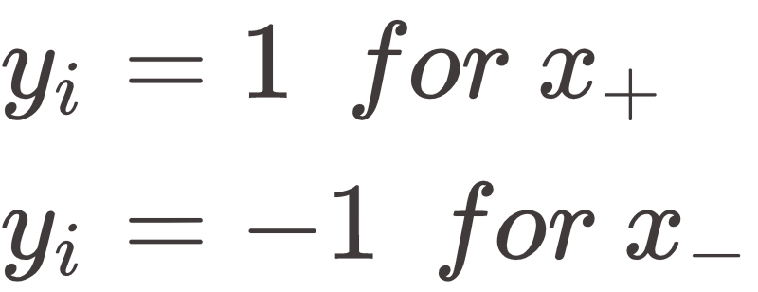
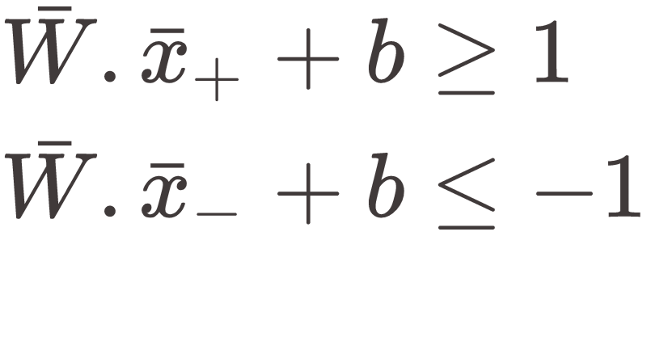
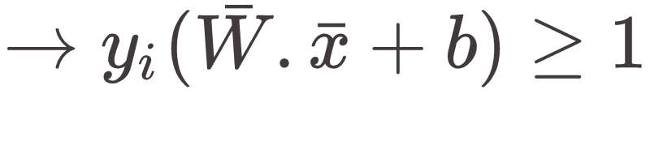
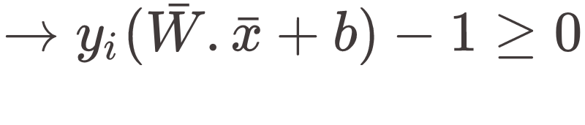
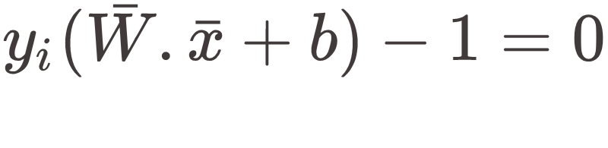
SVM Constraints
For points in the street:

Slide 6
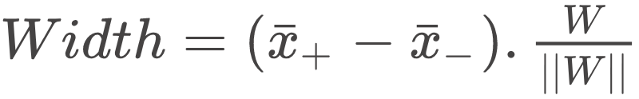
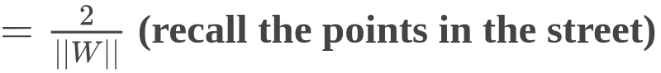
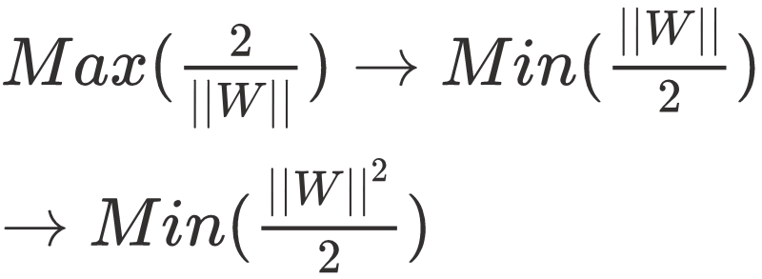
SVM constraints

Slide 7
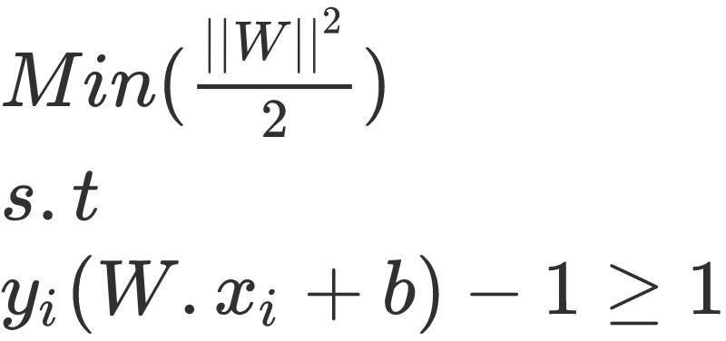
SVM cost function
We use Lagrange multipliers to find the cost function.

Slide 8
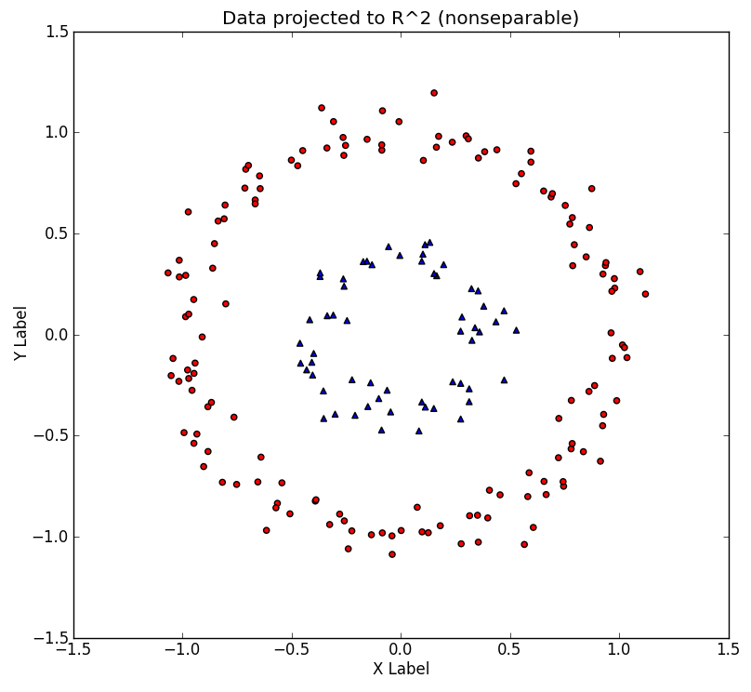
What if !?

Slide 9
Kernel Trick

Slide 10
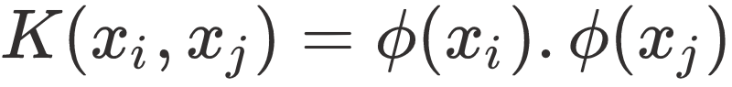
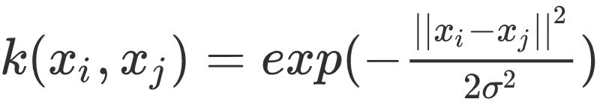
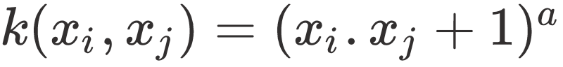
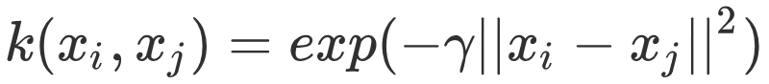
Kernel Trick
Popular Kernels:
Linear : No kernel
Gaussian :
Polynomial :
RBF:

Slide 11
Facts
Each training point can be inferred as a new features.
Works perfect on small or medium sized datasets.

Slide 12
Decision Tree

Slide 13
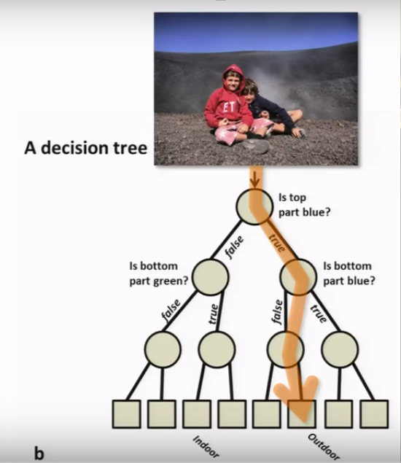
Decision Tree
Let’s check our features one by one to take a decision !

Slide 14
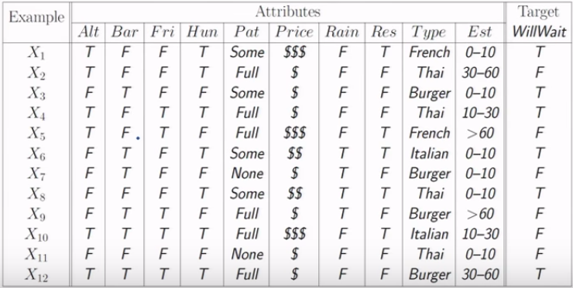
Dataset

Slide 15
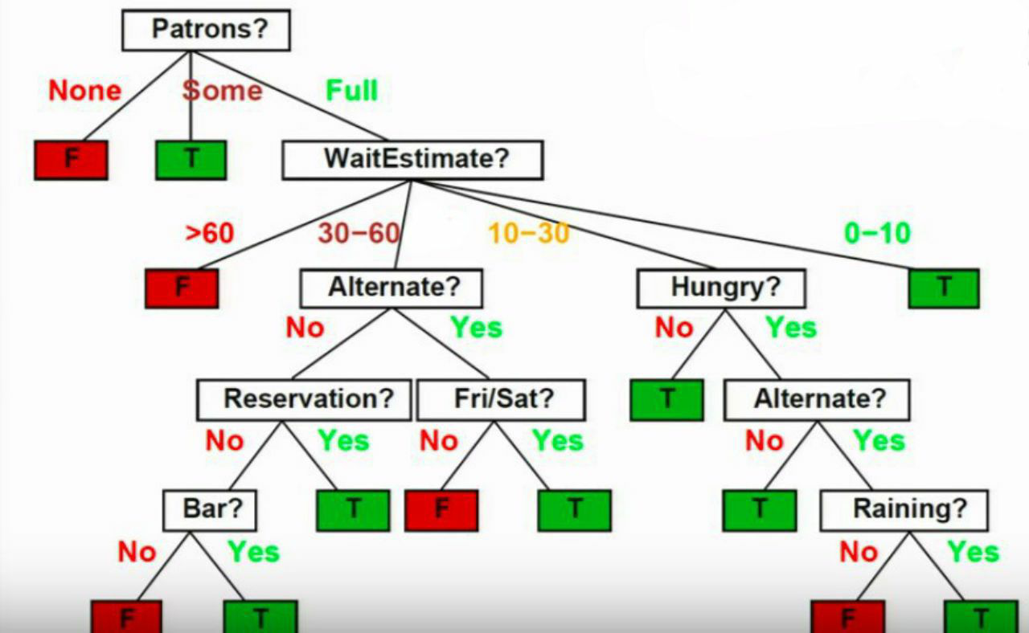
Decision Tree

Slide 16
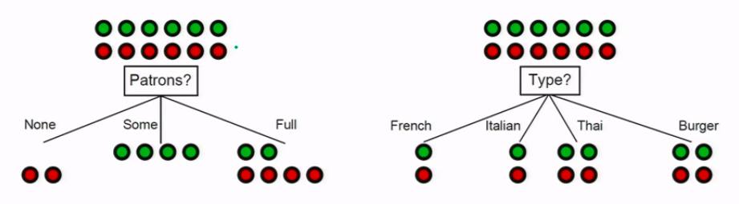
Feature to choose
Which one is a better choice ?
( Gives more information )

Slide 17
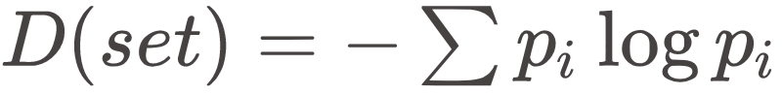
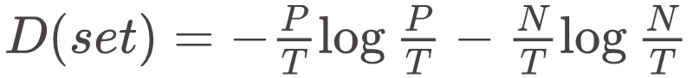
Disorder
In information Theory we have :
For binary classes :
Also called Entropy.

Slide 18
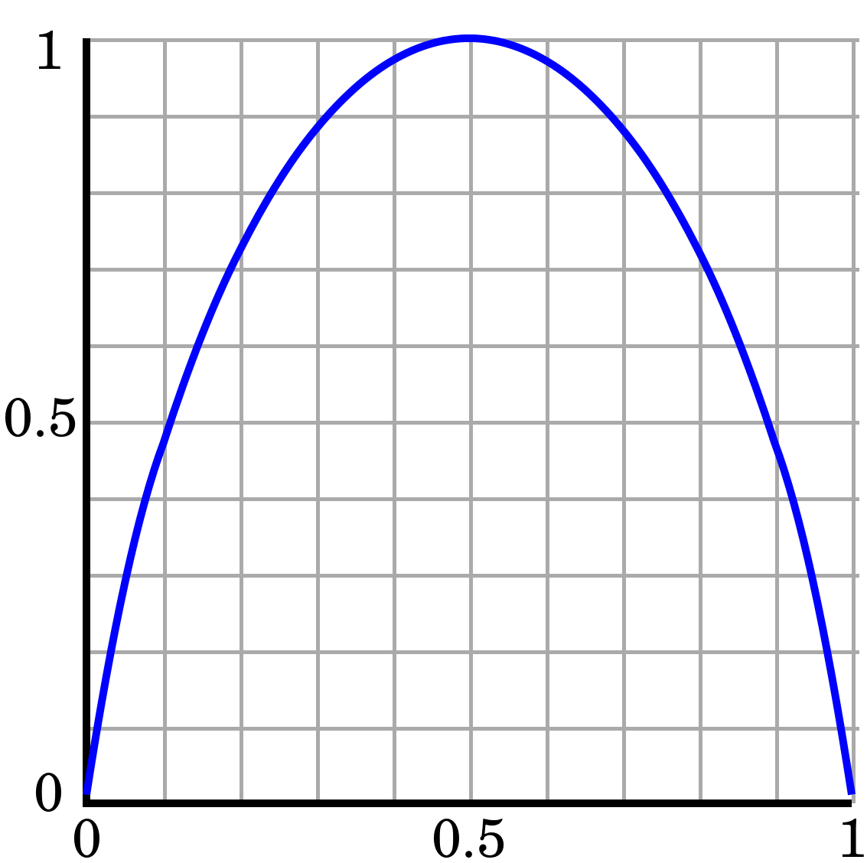
Disorder
If P/T == 1 then
D = 0
If P/T == 0 then
D = 0
If P/T == ½ then
D = 1

Slide 19
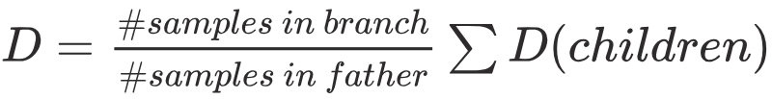
Disorder
What about disorder of each feature?
⅛
1
0
0
~¼ * ½
1 * ⅙
1 * ⅙
1 * ⅓
1 * ⅓

Slide 20
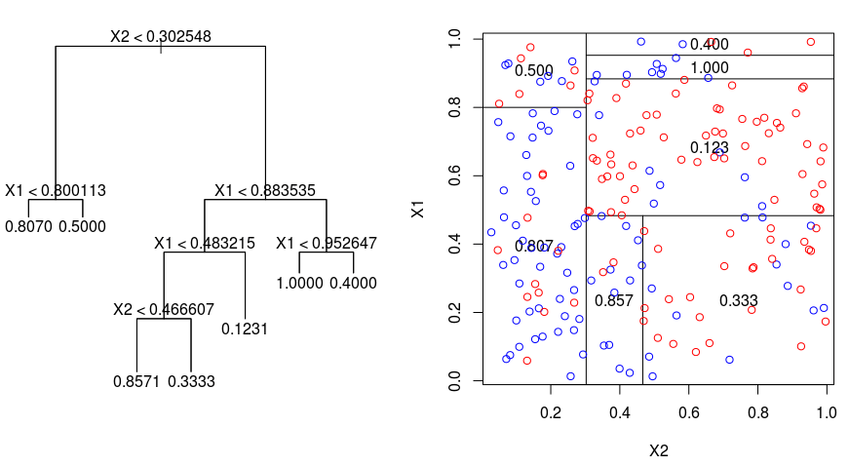
Numerical Features

Slide 21
Numerical Features
Pick different decision points
Check Disorder for each one
Ex. X < 2, X< 10, X < 0, ...

Slide 22
Ensemble Methods

Slide 23


Wisdom of the crowd !

Slide 24
Ensemble Methods
Combine many classifiers
Majority voting
Average
Weighted Average
Training another predictor to combine models

Slide 25
Bagging
Draw N’ of N samples with replacement
Train a classifier on this random set
Train many classifiers like this
Combine them through averaging (majority voting)

Slide 26
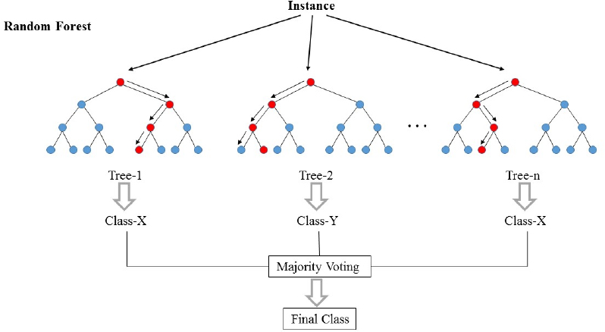
Bagging
Random Forests

Slide 27
Random Forests
Problem:
With lots of data we almost learn the same Tree every time
Solution:
Each time restrict the tree to a set of random features

Slide 28
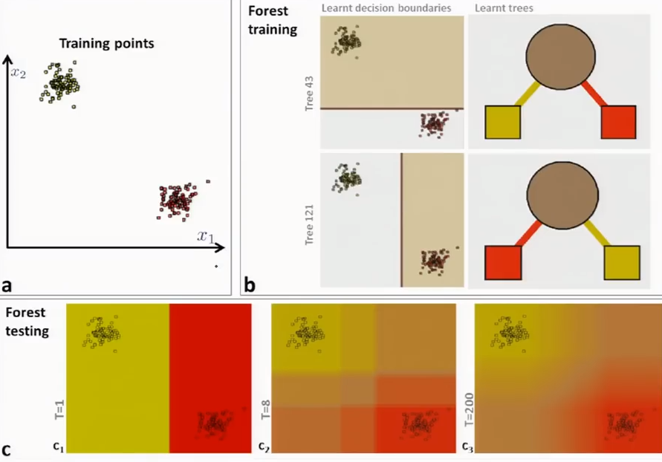
Effect of forest size

Slide 29
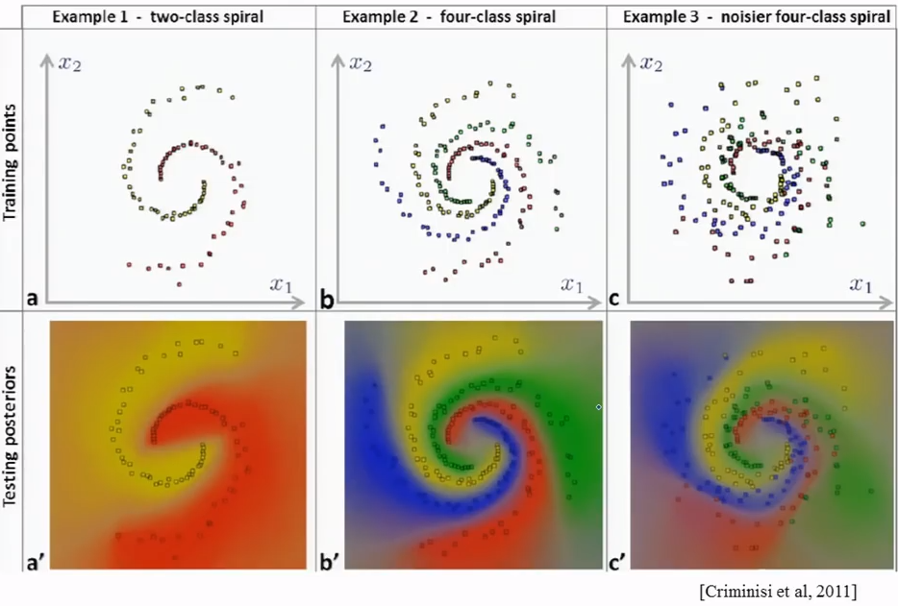
More classes and Noise

Slide 30
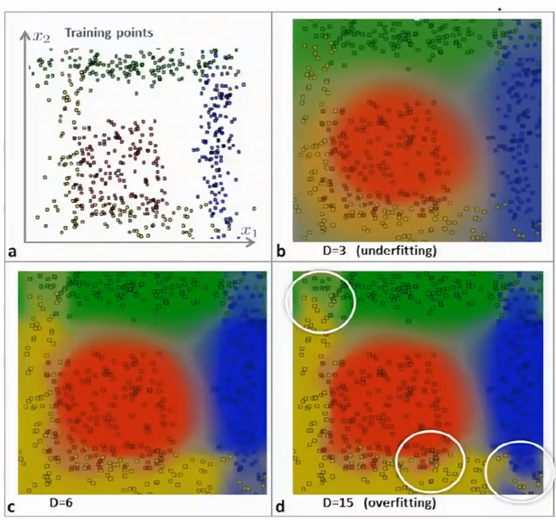
Effect of Tree Depth

Slide 31
Boosting
Use many weak learners to build a strong one
Focus new classifiers on samples that others got wrong (how?)
Not all classifier have the same weight for voting. Better ones, larger weights

Slide 32
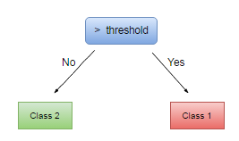
AdaBoost
Uses stumps as weak learners.
Lots of stumps can make a perfect decision boundary!

Slide 33
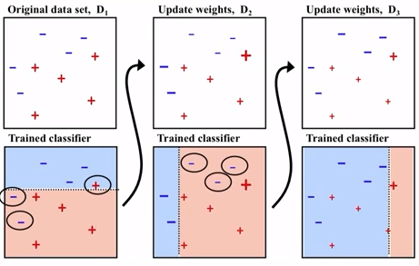
Sample weights

Slide 34
Hyperparameter Tuning

Slide 35
Hyperparameters
How to know the best value for :
Lambda (regularization parameter)
Tree depth
Forest size
Type of kernel in SVM
...

Slide 36
Search
Manual search
Test different values yourself!
Grid search
Test performance for preset list of values
Random search
Search for random numbers in a range of values

Slide 37
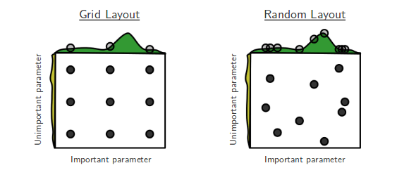
Grid search vs. Random search

